Slide 1


Slide 2


Slide 3
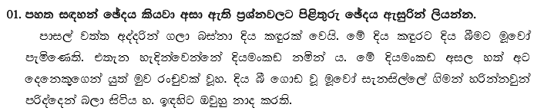
osh l`ÿrla
uqfjda $ uqjrxpqjla

Slide 4
jqy
hq;a

Slide 5
iekis,af,a .suka yßkakjqka mrsoafoka
osh $ uqj $ mdi,a

Slide 6

uqfjl= $ uqjl=
f.ú,shl

Slide 7
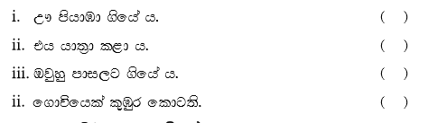
  
  
  
  

Slide 8




bgq fkdjk isysk ueúu
oeä i;=gg m;aùu
weúf,k .skakg msÿre fkdoukak
we`.s,af,a ;rug bosfukak

Slide 9

“Tn;=ud fuh úI iys; .ila nj oek .;af;a flfia o@”
.ï jeisfhda kdhl isgq;=udf.ka úuiQ y'

Slide 10



l= - flájla mdms,a, W Yíoh
fld - fldïnqj iys; we,ms,a, T Yíoh
How much is a pen?
I work in school

Slide 11

f,akd
isl=rdod
Tyq wdmam lkak leu;shs

Slide 12


isl=rdod
úiai
uu rdKs ' Tn ljqo@
Tfí mka;sh l=ula o@

Slide 13
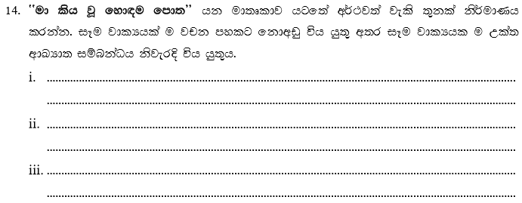

Slide 14
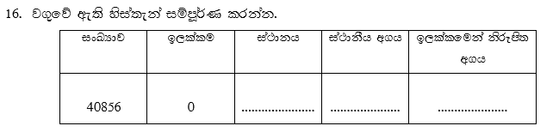
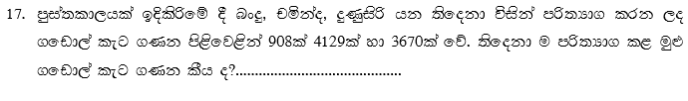
89 090
oyi ia:dkh
1000
0
8707

Slide 15



103
121
40
54
1345
16
0.7

Slide 16


1030
meh 2 hs ñks;a;= 50
14.30

Slide 17
1475
81km 975m
652Km 125m

Slide 18

re ' 459'50
re ' 40'50

Slide 19



7l 50ml
is,skavrh
290g

Slide 20
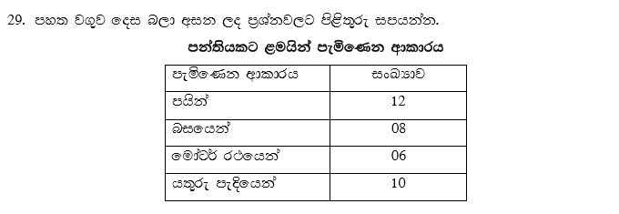
mhska
40

Slide 21
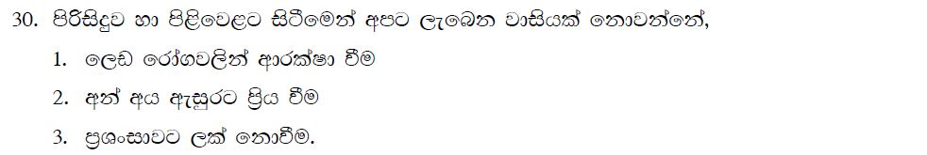
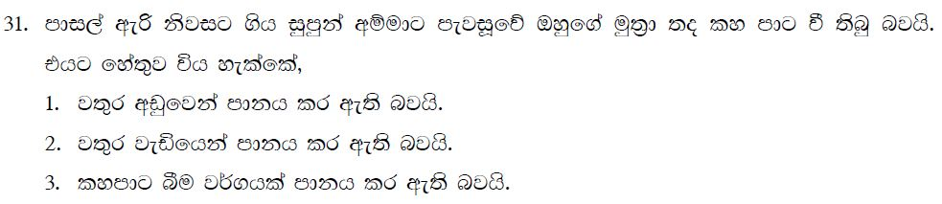

Slide 22
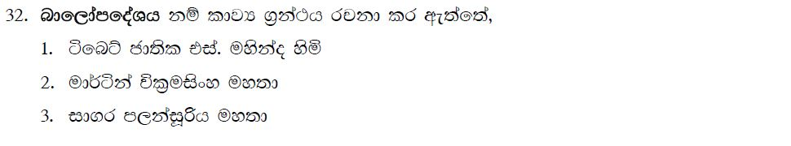
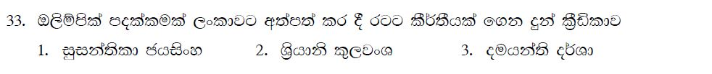
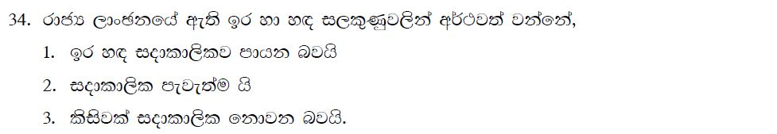

Slide 23
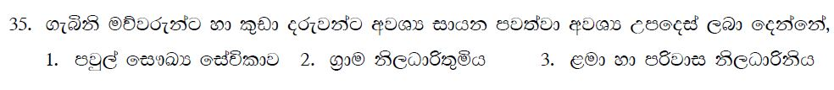

Slide 24
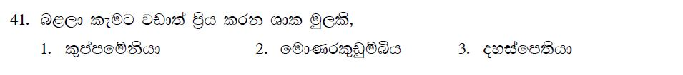

Slide 25
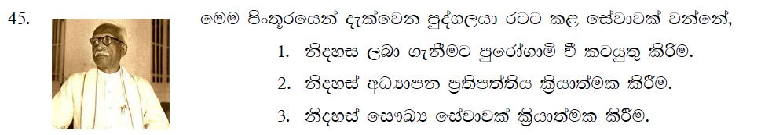

Slide 26
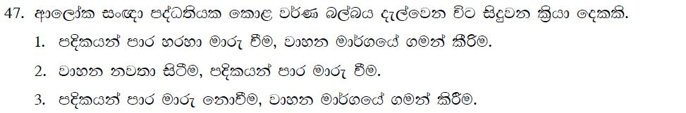
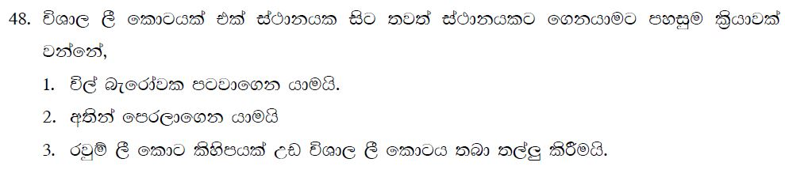

Slide 27
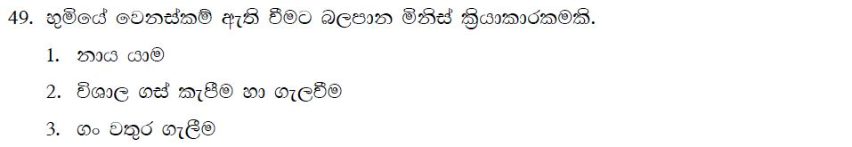
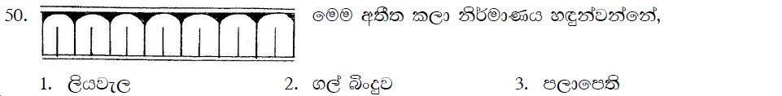

Slide 28

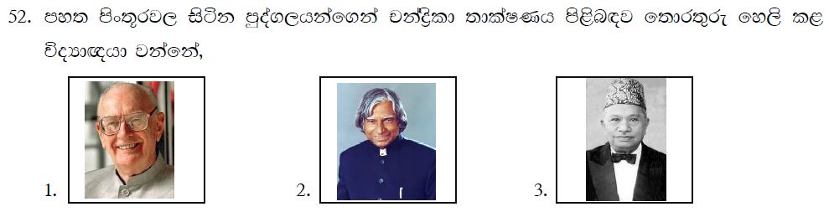

Slide 29
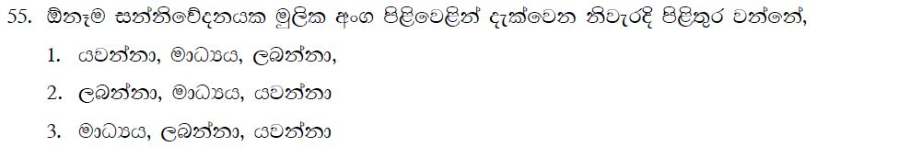

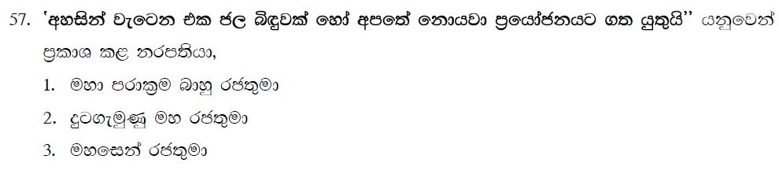

Slide 30
